Slide 1
R
Redress
Private claims.
Verifiable verdicts.
Privacy-preserving claims infrastructure on Midnight.
Wave 1 · Midnight Buildathon 2026
Redress Labs · @Emmanuellsensai
Notes:
Open on the Landing page. Say the tagline out loud.

Slide 2
2
THE PROBLEM
Every app has a dispute button.
It is broken for everyone.
Users
Email bank statements to strangers. Trust the platform to redact.
Companies
Custody sensitive evidence forever. Absorb the compliance liability.
Regulators
Cannot audit without a full data dump. Investigate blind or not at all.
Reporters
Have no proof of what they filed if the platform later denies it.
Redress · redress-app-two.vercel.app
Wave 1 · Midnight Buildathon 2026
Notes:
Frame the pain across four constituencies. Nobody is happy today.

Slide 3
3
THE SOLUTION
Private, AI-adjudicated, reporter-driven.
Redress puts the reporter in charge of the flow. The platform receives finalized decisions to act on.
1
2
3
Encrypted at source
AI panel of judges
Auditable by anyone
Evidence sealed to the platform key with a single-use ephemeral keypair. Plaintext never leaves the browser.
Specialised agents adjudicate fraud, refunds, chargebacks, KYC exceptions, and appeals. Reasoning stays private.
Regulators paste plaintext, re-hash locally, compare on-chain commitments. No exposure, no trust required.
Redress · redress-app-two.vercel.app
Wave 1 · Midnight Buildathon 2026
Notes:
Three-pillar solution overview. Set up the flow slide next.

Slide 4
4
THE FLOW
Four steps, all driven by the reporter.
01
02
03
04
Submit
Adjudicate
Decide
Verify
Reporter encrypts evidence to the platform key. Envelope and hash committed on-chain.
Same page calls the AI engine with the plaintext. Verdict returned in seconds.
Reporter approves the AI, rejects it, or escalates to a human. Their choice is what commits.
Anyone with the plaintext later can re-hash locally and match the on-chain commitment.
Redress · redress-app-two.vercel.app
Wave 1 · Midnight Buildathon 2026
Notes:
Walk through each step. Emphasize step 3: the reporter is in control.

Slide 5
5
MIDNIGHT INTEGRATION
Dual-ledger by design.
Private witnesses on the shielded side. Public commitments on the transparent side. persistentHash bridges them inside a ZK circuit.
PRIVATE
PUBLIC
Off chain, ZK witness
On chain, anyone can read
Evidence plaintext
Evidence + verdict hashes
Verdict reasoning
Encrypted envelopes
persistentHash
Platform public key
Sender identity
Claim + verdict counters
Contract on Preprod: 3bc1d920…3c68c
Redress · redress-app-two.vercel.app
Wave 1 · Midnight Buildathon 2026
Notes:
Explain persistentHash as the bridge. Say: the private thing and the public thing are provably the same, without the private thing leaking.

Slide 6
6
ARCHITECTURE
Four moving parts, nothing exotic.
1
Compact contract
2
SDK
3 circuits: register_platform, submit_claim, post_verdict. Deployed on Preprod.
Chain provider wiring, nacl.box envelope crypto, DApp Connector wallet bridge.
3
Frontend
4
Verdict engine
React 19 + Vite 8. Four routes: submit, dashboard, verify, deploy. Plus Jakarta Sans.
Vercel serverless. Gemini 2.5 Flash primary, Groq Llama 3.3 70B fallback, JSON-only.
Reporter → SDK → Contract and Reporter → Verdict engine → Gemini / Groq
Redress · redress-app-two.vercel.app
Wave 1 · Midnight Buildathon 2026
Notes:
Nothing esoteric here. Each box maps to a directory in the repo.

Slide 7
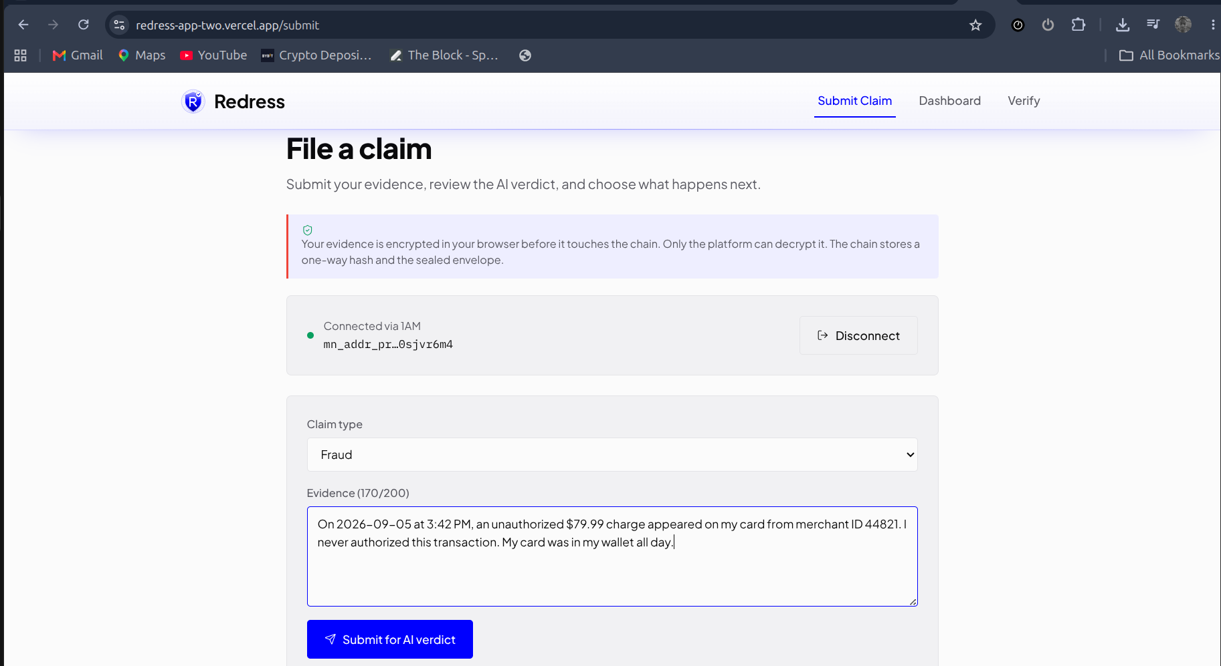
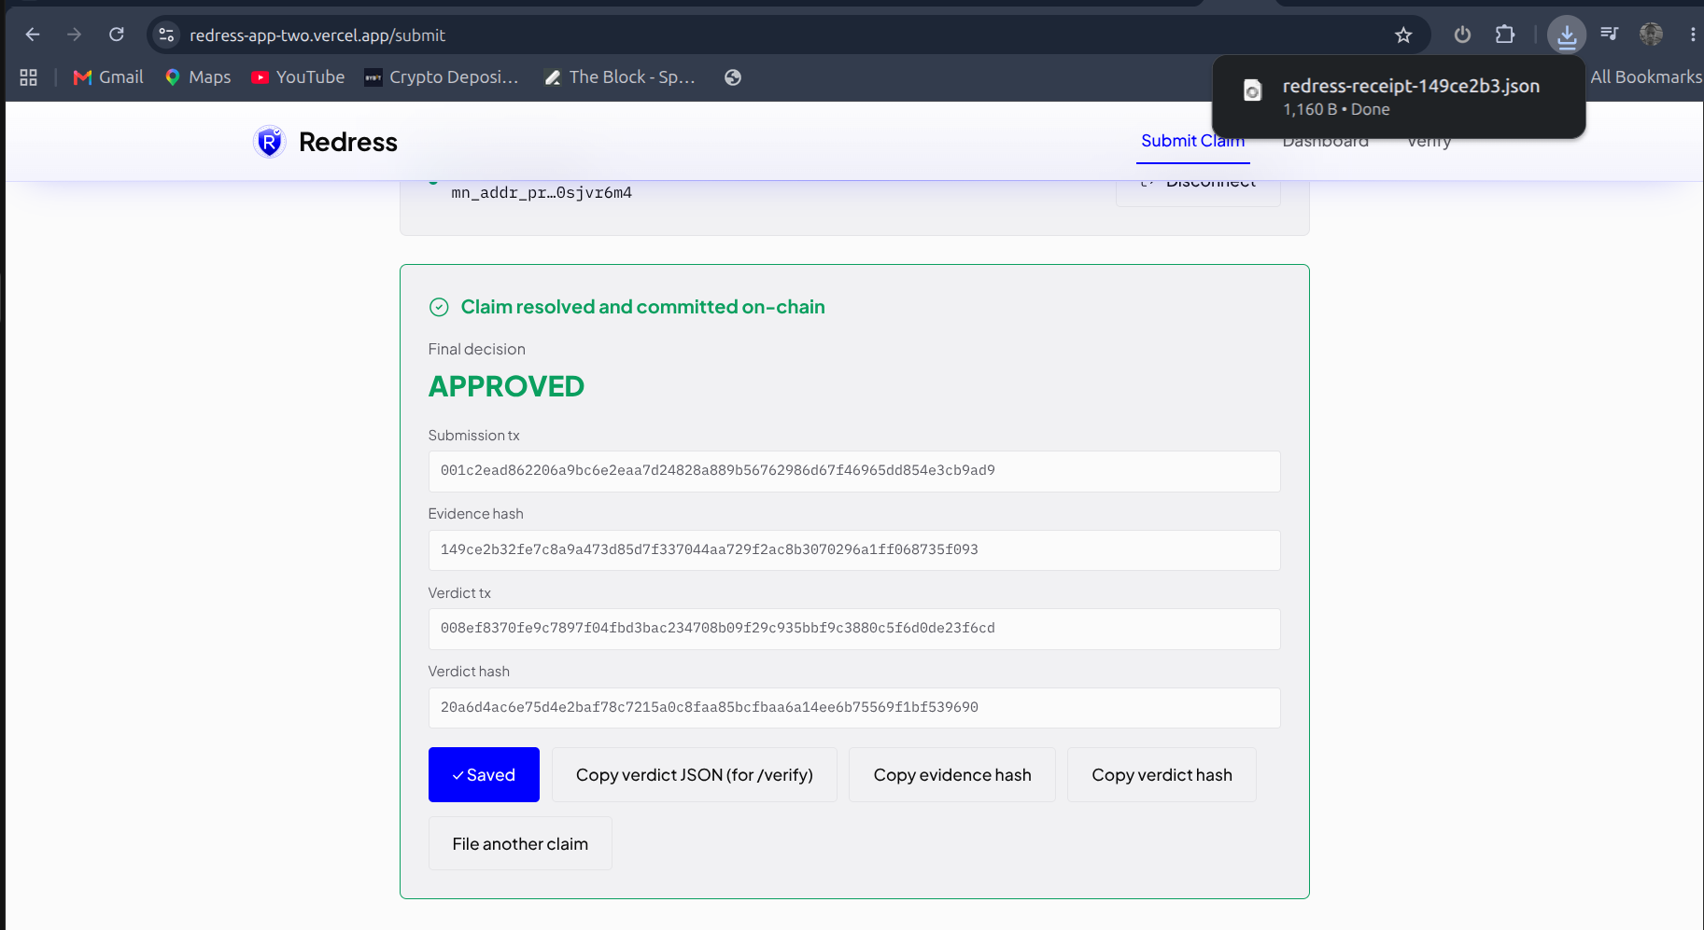
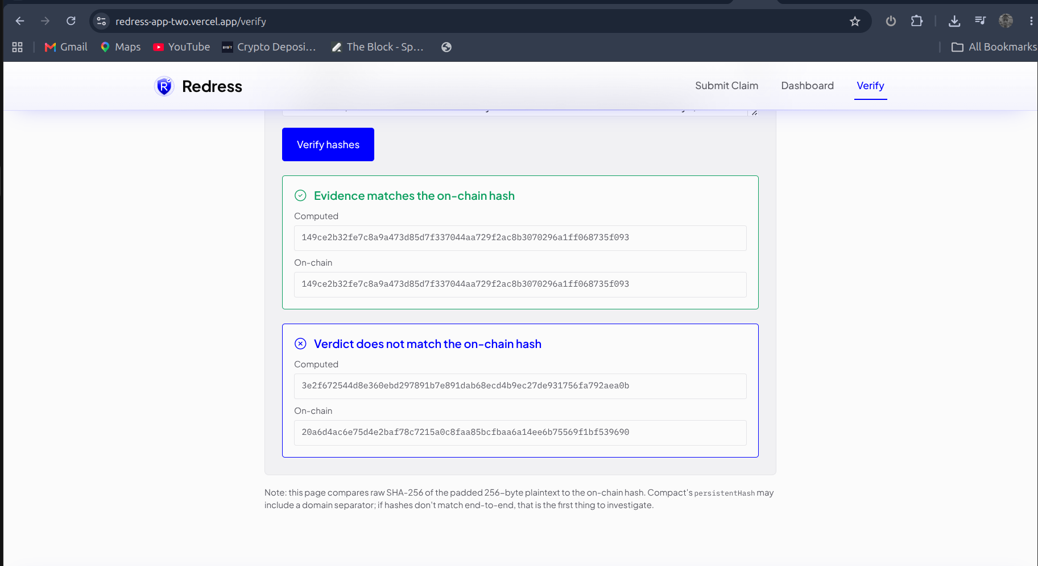
7
DEMO HIGHLIGHTS
What the demo will show.
Three screens the video walks through end-to-end.
[ SCREENSHOT ]
[ SCREENSHOT ]
[ SCREENSHOT ]
Submit + AI verdict
Done + receipt
Regulator verifies
Submit + AI verdict
Done + receipt
Regulator verifies
Reporter sees the AI decision and picks Approve, Reject, or Escalate.
Both on-chain hashes visible. Download claim receipt saves the proof to a JSON file.
No wallet. Paste plaintext, click Verify hashes, green matches on both.
Redress · redress-app-two.vercel.app
Wave 1 · Midnight Buildathon 2026
Notes:
Say: full flow in the linked demo video. Point at each screenshot as you narrate.

Slide 8
8
PRIVACY MODEL
What the chain sees. What stays with you.
👁
PUBLIC ON CHAIN
🔒
PRIVATE OFF CHAIN
Claim + verdict counters
Evidence plaintext
Platform public key
Verdict reasoning
Encrypted envelopes (512 bytes each)
Sender identity (ephemeral)
Evidence + verdict hashes
Reporter's downloaded receipt
Ephemeral keypair per envelope → sender identity is cryptographically unrecoverable.
Redress · redress-app-two.vercel.app
Wave 1 · Midnight Buildathon 2026
Notes:
Pause on this slide. The two columns are the whole pitch.

Slide 9
9
ROADMAP
Wave 1 shipped. Waves 2 and 3 in view.
WAVE 1
shipped
WAVE 2
planned
WAVE 3
planned
Single-party claim reporting
Two-party disputes
Human reviewer marketplace
AI adjudication + reporter accept/reject/escalate
Encrypted file evidence beyond text
Staked reputation for reviewers
Downloadable JSON receipt
Multi-model verdict panel with majority voting
Pilot integration with a Midnight-native app
Browser verification, no wallet needed
Automated platform-side resolution webhooks
Redress · redress-app-two.vercel.app
Wave 1 · Midnight Buildathon 2026
Notes:
Emphasize Wave 1 shipped. Wave 2 has real deliverables mapped out.

Slide 10
10
TEAM
Solo build. Not a solo history.
Emmanuel
@Emmanuellsensai
Midnight Aliit Fellowship Builder
Nightforce Charlie · Community leadership
Eclipse Content Bounty · Tier 2 winner
Anonymous Whispers dApp · Privacy-preserving whistleblowing on Midnight
Redress · redress-app-two.vercel.app
Wave 1 · Midnight Buildathon 2026
Notes:
Say: Redress isn't a first attempt on Midnight. Reference the prior work.

Slide 11
THE ASK
Try it. Break it. Build with it.
Feedback
on the reporter-centric claims model — what would you change?
Collaborators
for Wave 2. Two-party disputes need a co-designer.
Pilot integrations
with any Midnight-native app that has a dispute or refund flow.
redress-app-two.vercel.app · github.com/Emmanuellsensai/redress-app · @Emmanuellsensai
Notes:
Close on the CTAs. Read the URL. Land the pitch.

